Slide 2
Vakiintuneet kustantajat ja uudet yrittäjät OA-monografiamaailmassa
Routledge Books OA (Taylor & Francis), Brill Open, Palgrave Open Access monographs ja Palgrave Pivot-teokset (osa Springeriä ensi vuodesta lähtien), SpringerOpen, Ashgate and Gower OA policies
Open Book Publishers, OpenEdition, Open Humanities Press, OAPEN
The Monograph – an Old-Fashioned Publication Forum or an Ultimate Scholarly Achievement? by Sari Kivistö and Sami Pihlström (pdf)
[Perustuu Marjo Kuuselan ja Matti Myllykosken selvityksiin]

Slide 3
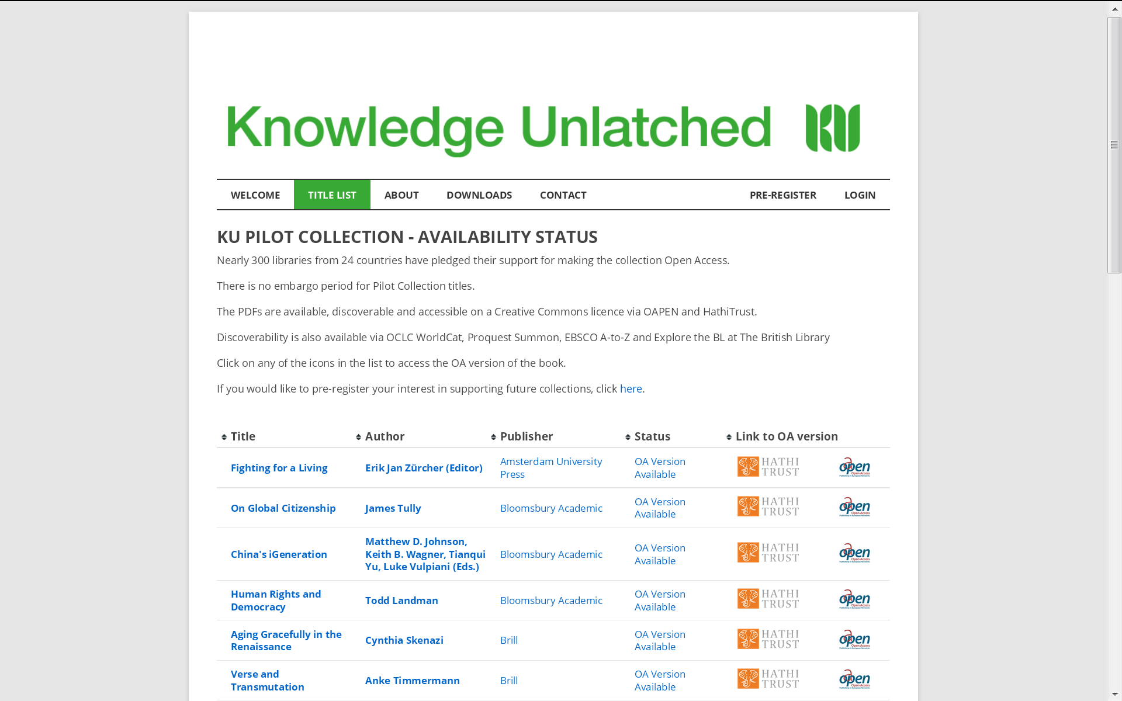

Slide 5
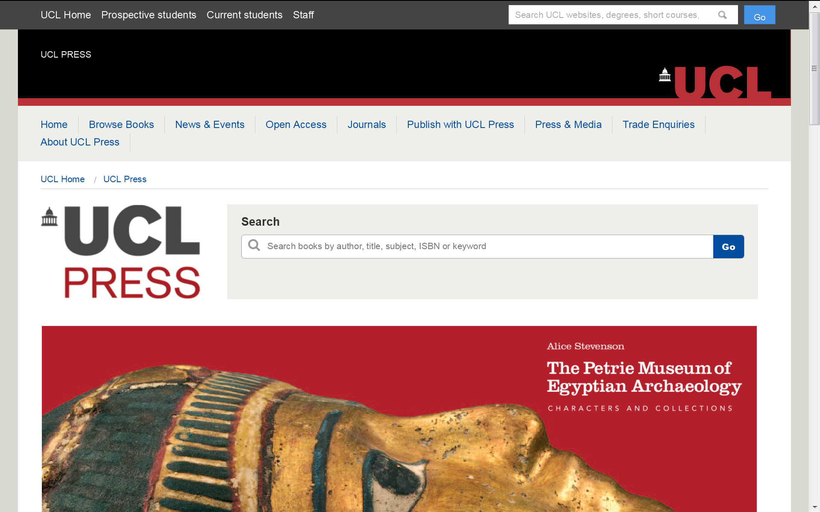

Slide 6
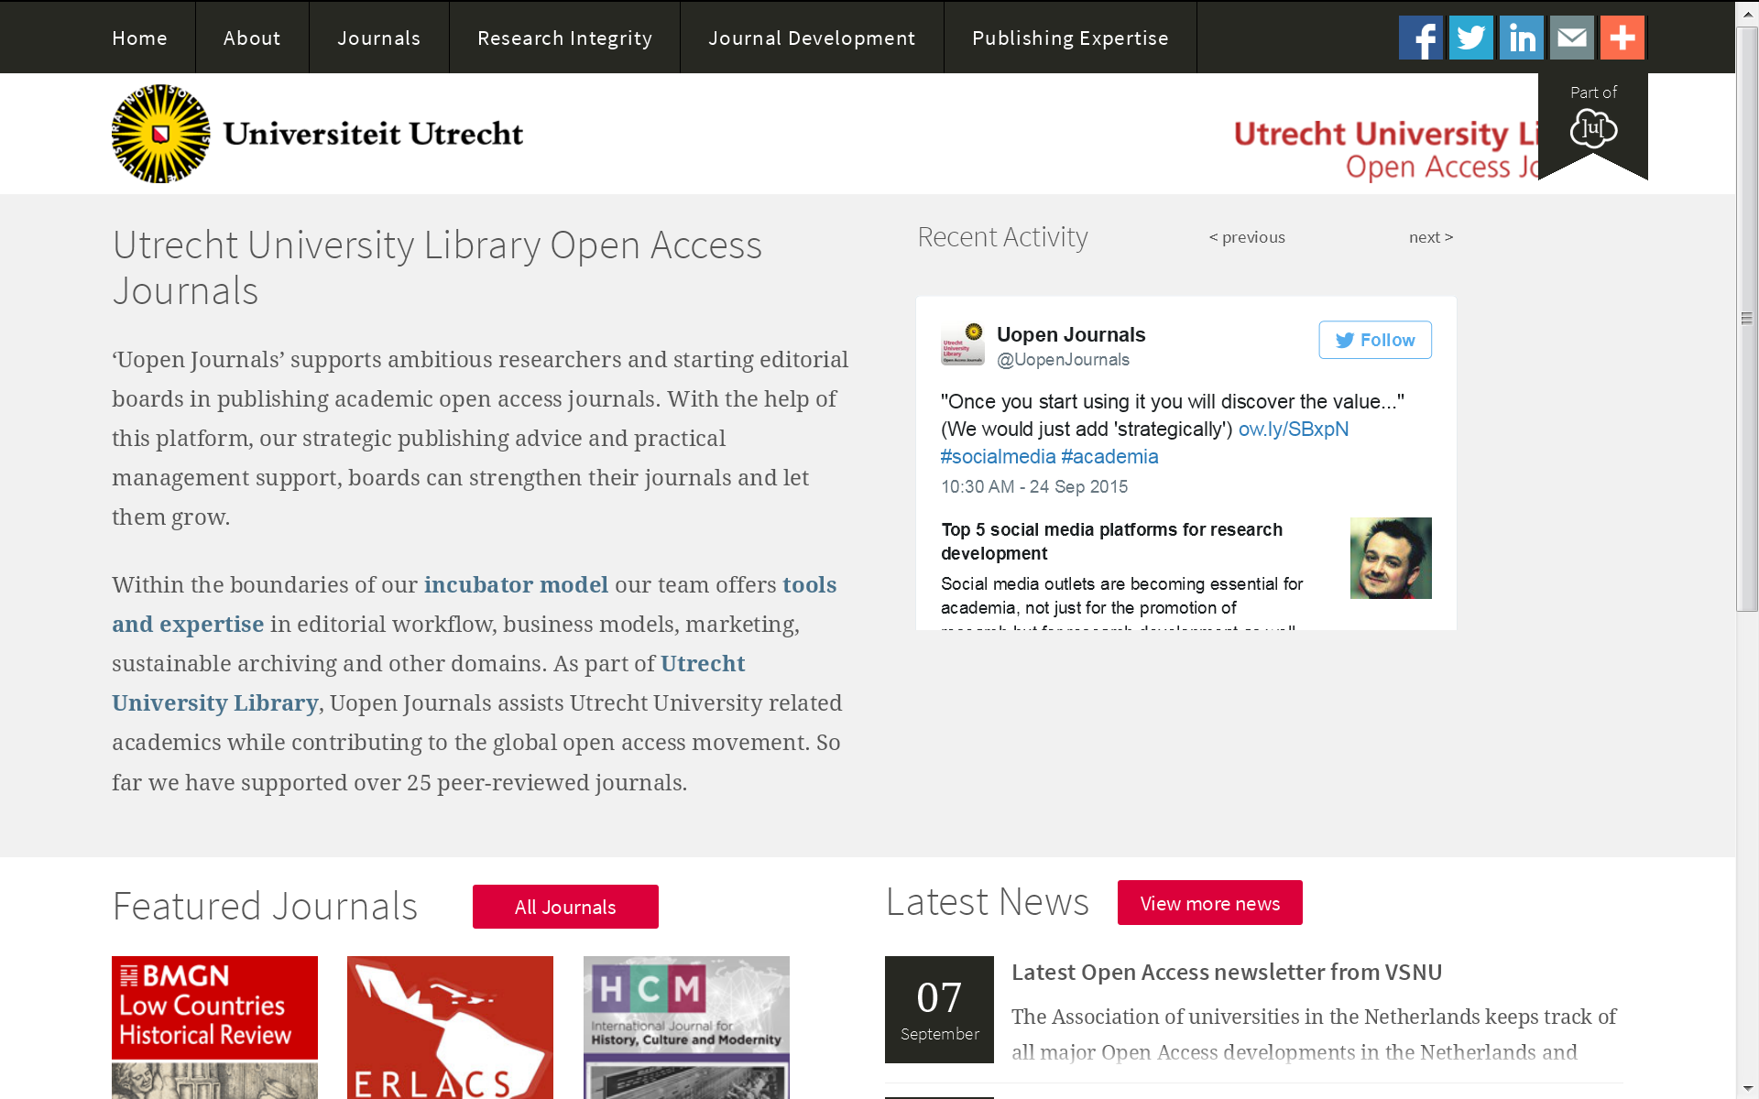

Slide 7
What can we do?
We can go only so far with agreements. What we need is exceptions to copyright laws making it possible for researchers to data mine and to search for information as effectively as possible
We should support the movement towards Open Access and Open Science
We should find new ways of doing things (e.g., publishing of OA monographs)
We need to get involved!

